Slide 1
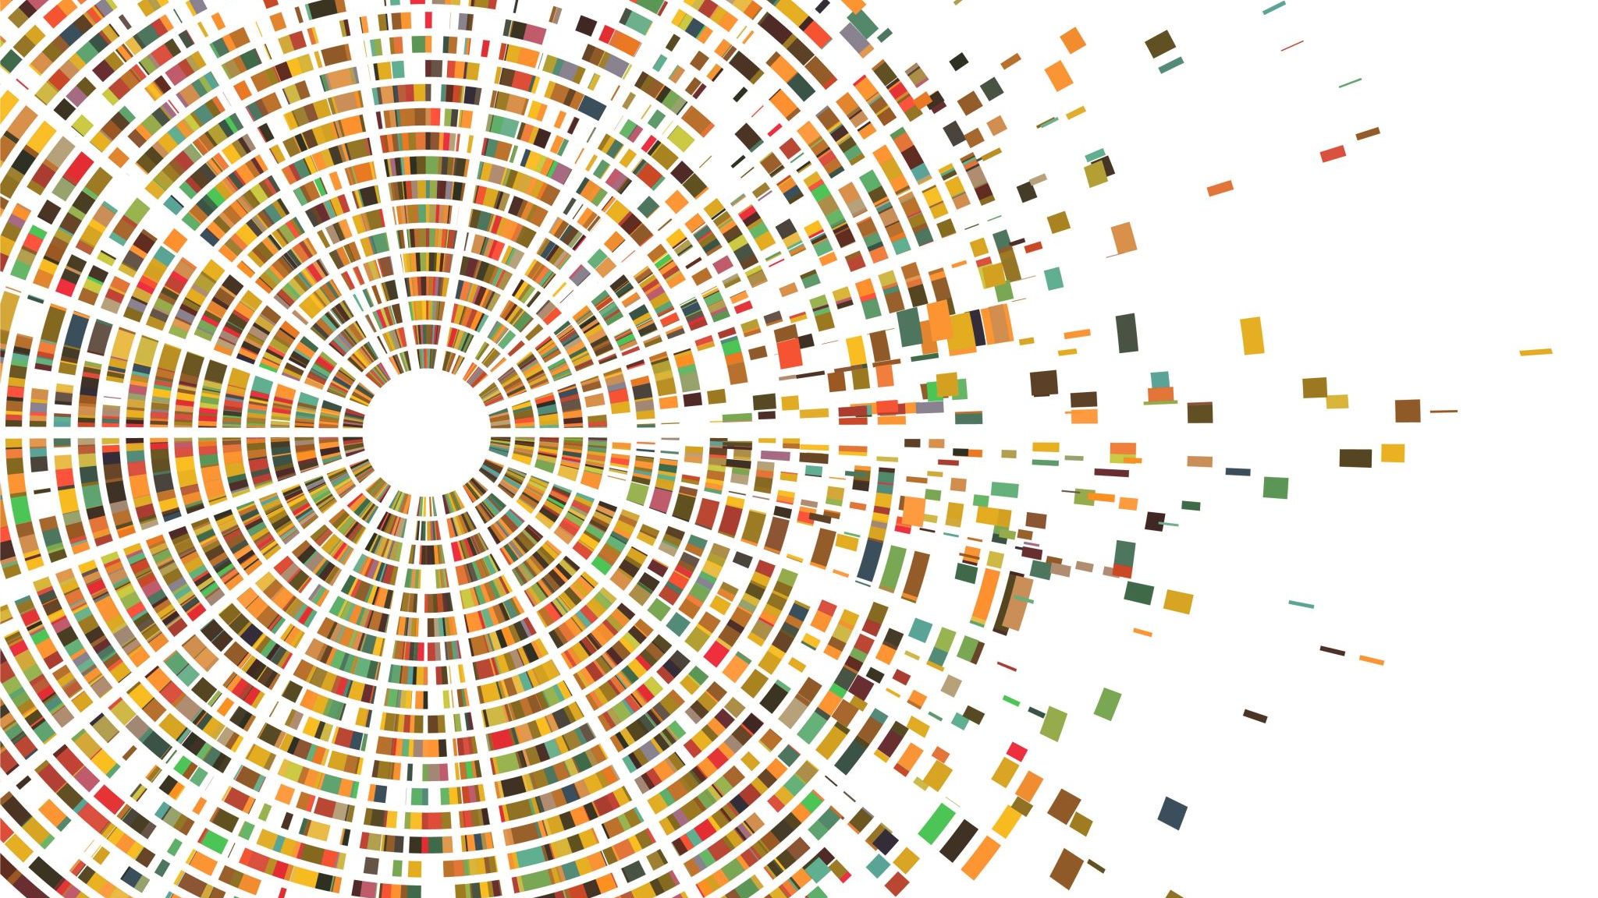
Lists, Tuples, Dictionaries, and Sets in Python
Lecture 10

Slide 2
Introduction Understanding Python Data Collections
Why Do We Need Collections?
In real life, we often work with groups of data — not just one value.
Example: A list of student names, shopping items, or test scores.
Using single variables for each item is inefficient and messy.
❌ name1 = "Sara"
❌ name2 = "Alex"
✅ Use one collection like ["Sara", "Alex"]

Slide 3
Introduction What Are Collections?
Collections let us store multiple values in one variable.
They help us:
Organize data
Search, update, and delete easily
Write cleaner and shorter code

Slide 4
Introduction The Four Main Collection Types in Python
Type | Description
List | Ordered, changeable, allows duplicates
Tuple | Ordered, cannot change, allows duplicates
Dictionary | Key-value pairs, fast lookup
Set | Unordered, unique values only

Slide 5
List Definition
A list is a collection used to store multiple items in a single variable.
It is:
Ordered – items keep their position.
Mutable – you can change, add, or remove items.
Allows duplicates – same value can appear more than once.

Slide 6

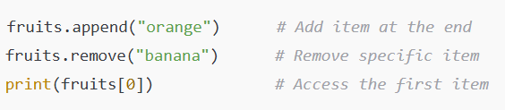
List
Syntax
Items are written between square brackets []
Separated by commas
Key Operations
Use .append() to add
Use .remove() to delete
Use indexing [ ] to access

Slide 7
List Examples in Real Life
🛒 Shopping cart items
cart = ["milk", "bread", "eggs"]
👨‍🎓 Student names in a class
students = ["Ali", "Nina", "David"]
Mini Tip:
Index starts from 0
So fruits[0] is "apple"

Slide 8
List Activities - Lists
Create a list of 5 favorite movies
Remove one movie and add a new one
Print all movie names one by one

Slide 9
Tuples Definition
A tuple is a collection used to store multiple items.
It is:
Ordered – the order of items doesn’t change.
Immutable – you cannot change, add, or remove items after creation.
Allows duplicates

Slide 10

Tuples
Syntax
Items go inside round brackets ()
Separated by commas
Once a tuple is created, you cannot modify its values.
Use a tuple when your data should not change.

Slide 11

Tuples Common Use Cases
📍 Coordinates in maps
location = (6.9271, 79.8612)
🎨 RGB color values
color = (255, 0, 127)
📏 Screen resolution
resolution = (1920, 1080)

Slide 12
Tuples vs Lists
Feature | List | Tuple
Syntax | [] | ()
Mutability | Mutable | Immutable
Performance | Slower | Faster
Use Case | Varying data | Fixed data

Slide 13
Dictionaries Definition
A dictionary stores data in key-value pairs.
It is:
Unordered (in older Python versions, order not guaranteed)
Mutable – you can change, add, or delete items.
Unique keys – keys must be different, but values can repeat.

Slide 14
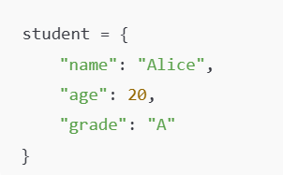
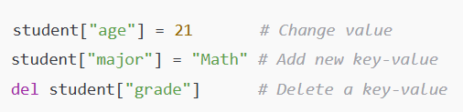
Dictionaries Syntax and Key Operations
Use curly braces {}
Each item is written as "key": value
Access by key, not by position.
Use del to remove a pair.

Slide 15

Dictionaries
Example
Common Use Cases
Student profile (name, age, grade)
Product details (name, price, quantity)
User account data (username, email, ID)
"name" is the key
"Alice" is the value

Slide 16
Sets
A set is a collection that stores unique items only.
It is:
Unordered – the items have no fixed order.
Mutable – you can add or remove items.
No duplicates allowed

Slide 17


Sets
Syntax
Key Operations
Output will be: {1, 2, 3}
(Duplicate 2 is automatically removed)
Use curly braces {} just like a dictionary, but without key-value pairs.

